Slide 1

_{Object Oriented Programming} Introduction to Java
Ch. 8. Inheritance, Polymorphism and Interfaces
March 4, 2014
Dept. of Software, Gachon University
Ahyoung Choi, Spring

Slide 2
8.1 Inheritance Basics

Slide 3
Inheritance
Important questions:
What is inheritance?
How to use inheritance?
The biggest difficulty:
Inheritance is specifically used for “better design”
Design is harder than implementation, so you haven’t done much design

Slide 4
Motivation
Suppose designing a college record-keeping program
What types of data are required?
Many classes share the same fields and methods
E.g., name, phone number, …
You should not copy & paste the duplicate variables & methods
It is good to reuse codes
Undergraduate
Doctoral
Staff
Masters
Faculty

Slide 5
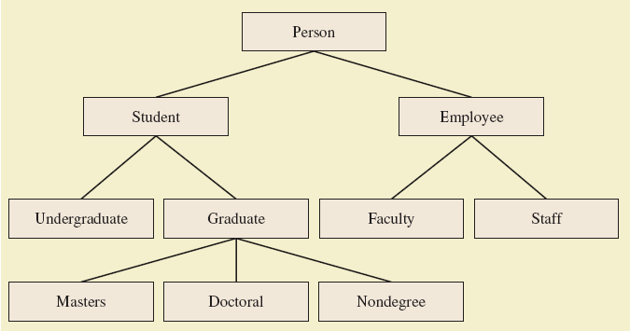
Class hierarchy
A way to organize classes
Derived classes share the characteristics of base class
Inherit variables and methods from base class
Also referred to as subclass and superclass

Slide 6
Syntax Rules
public class Derived_Class_Name extends Base_Class_Name
public class MountainBike extends Bicycle
After the inheritance, the subclass inherits all the public variables and methods of the superclass
Also, the subclass can add new variables and methods
Bicycle class has cadence, gear, speed, constructor and four setters
MountainBike class has cadence, gear, speed, seatHeight, constructor, four setters and a new setter setHeight()

Slide 7
Syntax Rules
Private members
Private instance variables in a superclass are not inherited in subclass
It can be accessed/modified only with public accessor/mutator methods in the superclass
Similarly, private methods in a superclass are not inherited in subclass
Access modifier | Same class | Same package | Subclass | Other
public | ✓ | ✓ | ✓ | ✓
protected | ✓ | ✓ | ✓ | ✗
private | ✓ | ✗ | ✗ | ✗

Slide 8
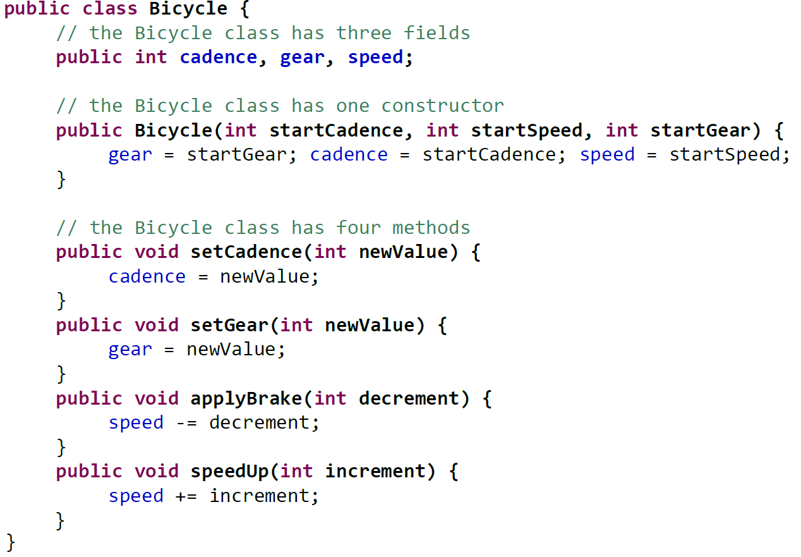
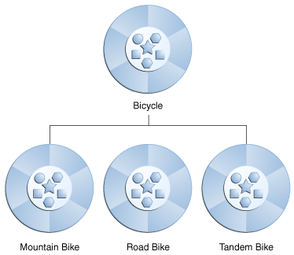
Example: class Bike

Slide 9
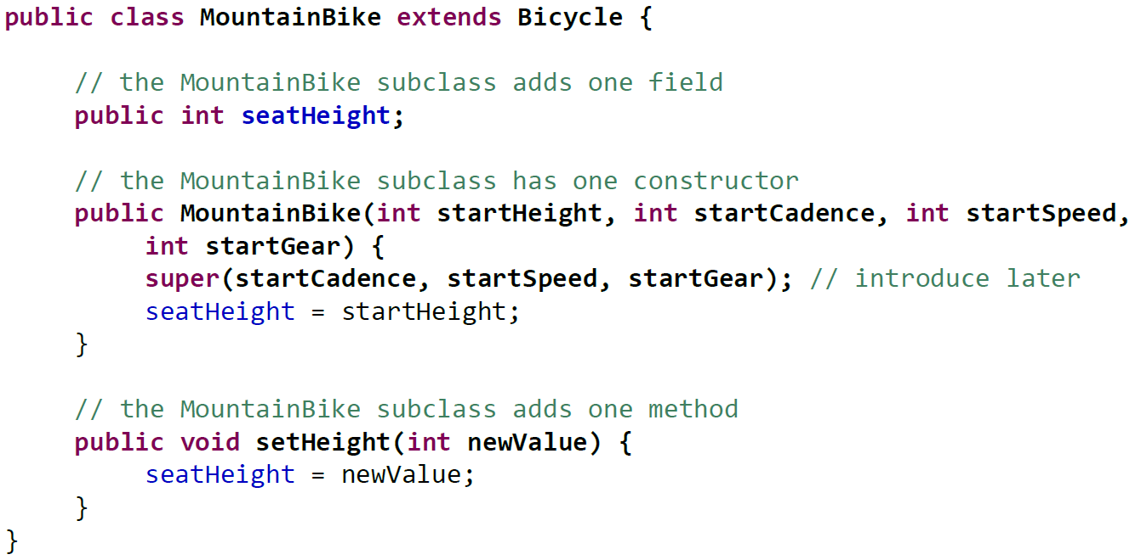
Example: class MountainBike
MountainBike
All properties are same with Bike except that its seatHeight is adjustable

Slide 10

Lab: Derived Classes
View derived class, listing 8.2 class Student extends Person
View demo program, listing 8.3 class InheritanceDemo

Slide 11
Lab
int studentNumber
super
String name
this
Superclass
public class Person {
private String name;
public Person() {
name = "No name yet";
}
public Person(String initialName) {
name = initialName;
}
public void setName(String newName) {
name = newName;
}
public String getName() {
return name;
}
public void writeOutput() {
System.out.println("Name: " + name);
}
public boolean hasSameName(Person otherPerson) {
return this.name.equalsIgnoreCase(otherPerson.name);
}
}
Subclass
public class Student extends Person {
private int studentNumber;
public Student() {
super();
studentNumber = 0;
}
public Student(String initialName, int initialStudentNumber) {
super(initialName);
studentNumber = initialStudentNumber;
}
public void reset(String newName, int newStudentNumber) {
setName(newName);
studentNumber = newStudentNumber;
}
public int getStudentNumber() {
return studentNumber;
}
public void setStudentNumber(int newStudentNumber) {
studentNumber = newStudentNumber;
}

Slide 12
Lab: test class
public class InheritanceDemo
{
public static void main (String [] args)
{
Student s = new Student ();
s.setName ("Warren Peace");
s.setStudentNumber (1234);
s.writeOutput ();
}
}
// we did not define setName() in the class Student

Slide 13

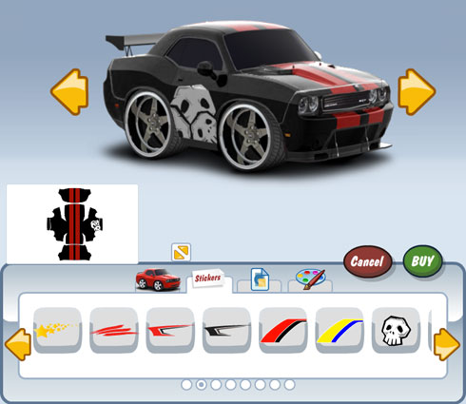
Question
What if you want to customize some methods of the superclass ?

Slide 14

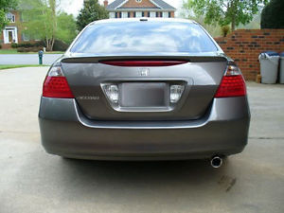

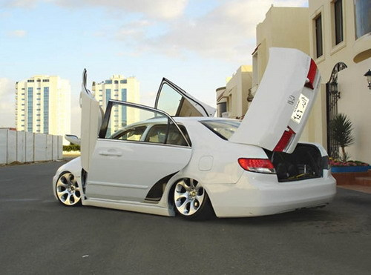
If want to tune openTrunk() method?
Superclass (base class)
openTrunk()
Inherit
openTrunk()

Slide 15
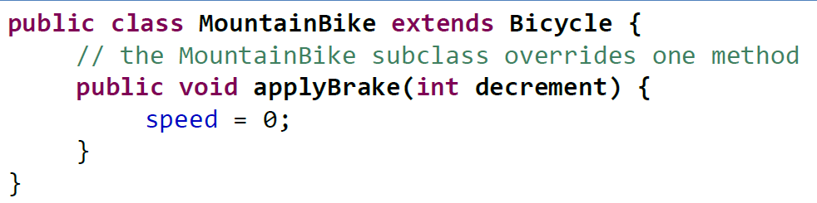
More Inheritance: Override
You can write a method (and variables) in the subclass to rewrite/replace the method with the same name in the superclass
Note method writeOutput in class Student (listing 8.2)
Class Person also has method with that name
For example, the MountainBike has a powerful break so it immediately reduce the speed to 0
Now if we call mb.applyBrake(3), the speed will be 0

Slide 16
Overriding Method Definitions
Method in subclass with same signature overrides method from base class
Overriding method is the one used for objects of the derived class
Overriding method must return same type of value

Slide 17
Overriding vs Overloading
Overriding vs. overloading
Overriding: a method in subclass with the same signature
Overloading: methods with the same name and different parameters in the same class
public class BaseClass {
public void m(int a) {
System.out.println("B1");
}
public void m(int a, int b) {
System.out.println("B2");
}
}
public class DerivedClass extends BaseClass {
@Override
public void m(int a) {
System.out.println("D1");
}
public static void main(String[] args) {
DerivedClass b = new DerivedClass();
b.m(0); // D1
b.m(0, 0); // B2
}
}

Slide 18
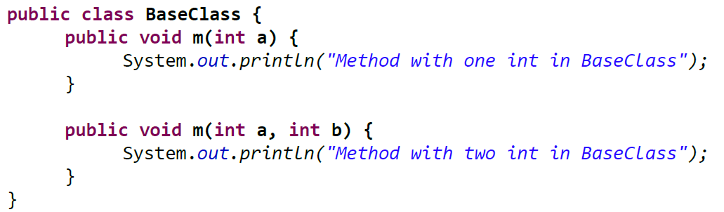
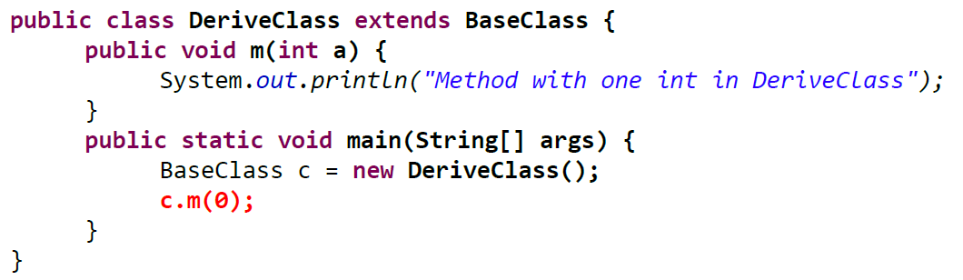
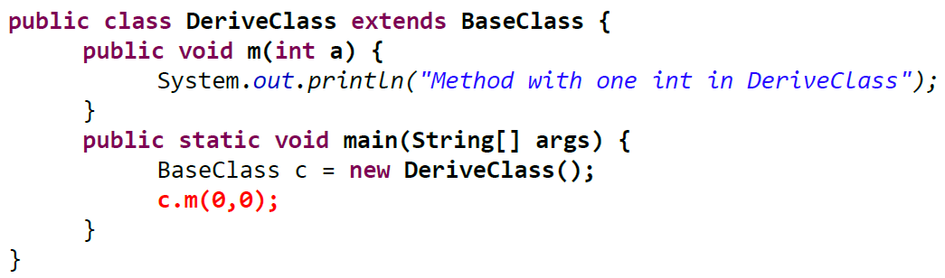
Overriding vs Overloading
Overloading!
Overriding!
Output ?
Output ?

Slide 19
final Modifier
Possible to specify that a method cannot be overridden in subclass
Add modifier final to the heading public final void specialMethod()
An entire class may be declared final
cannot be used as a base class to derive any other class

Slide 20
Private Instance Variables, Methods
Consider private instance variable in a base class
It is not inherited in subclass (but! accessible )
It can be manipulated only by public accessor, modifier methods
Similarly, private methods in a superclass not inherited by subclass

Slide 21
Problem ?
public class Person
{
private String name;
…
}
public class Student extends Person
{
…
public void reset(String newName, int newStudentNumber)
{
name = newName;
studentNumber = newStudentNunmber;
}

Slide 22
Example
public class Person
{
private String name;
…
}
public class Student extends Person
{
…
public void reset(String newName, int newStudentNumber)
{
// name = newName; // ILLEGAL !
setName(newName); // valid !!
studentNumber = newStudentNunmber;
}
The derived class does not inherit private variables. Thus, you should use mutator methods to set the value

Slide 23
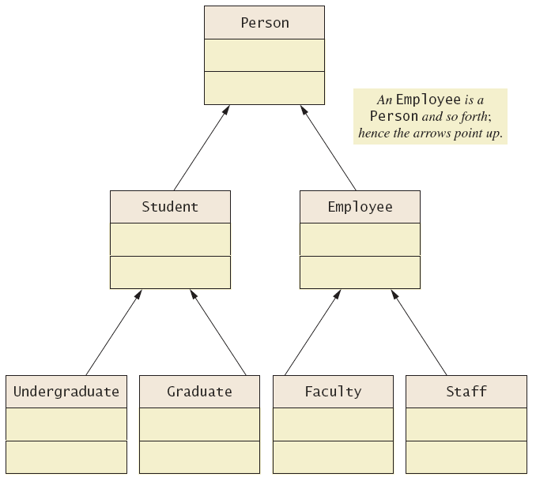
UML Inheritance Diagrams
Figure 8.2 A class hierarchy in UML notation

Slide 24
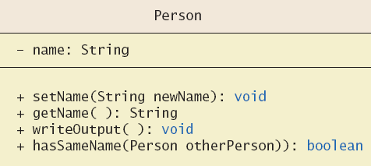
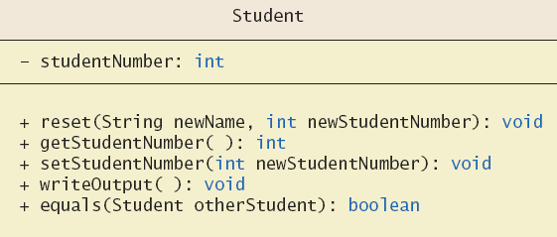
UML Inheritance Diagrams
Figure 8.3 Some details of UML class hierarchy from figure 8.2

Slide 25
Lab: Class Person and Student
Override
@Override
public void writeOutput() {
super.writeOutput();
System.out.println("Student Number: " + studentNumber);
}
public boolean equals(Student otherStudent) {
return this.hasSameName(otherStudent) &&
(this.studentNumber == otherStudent.studentNumber);
}
}
super
int studentNumber
this
String name

Slide 26
8.2 Programming with Inheritance

Slide 27
Fields/Methods in Extended Classes
An object of an extended class contains two sets of variables and methods
fields/methods which are defined locally in the extended class
fields/methods which are inherited from the superclass
What are the fields for a Student object in the previous example
How to initialize each set of the fields?

Slide 28
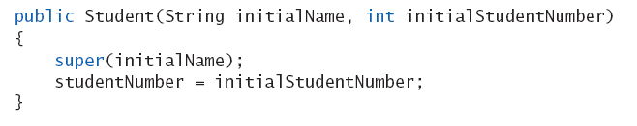
Constructors in Derived Classes
A derived class does not inherit constructors from base class
Usually, the initialization of the base class is required
Constructor in a subclass must invoke constructor from base class
Use the reserve word super
Must be first action in the constructor

Slide 29
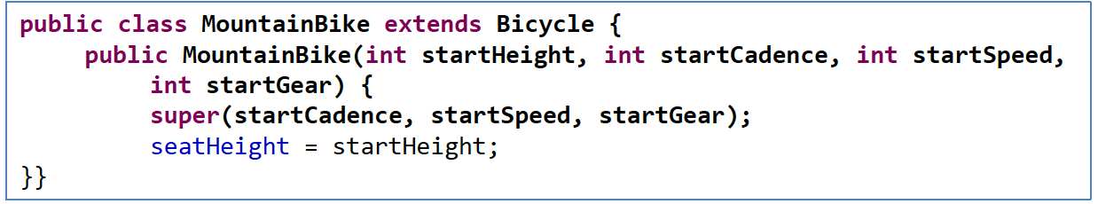
Using the Keyword super
super can be used to invoke superclass's constructor.
Detail:
It must be the first line in the subclass constructor
The default constructor super() will be automatically called if you do not include an explicit call to the base-class constructor
If the super class does not have a no-argument constructor, you must invoke the super class constructor with a matching parameter list

Slide 30
To Illustrate the Construction Order. . .
class X {
protected int xOri = 1;
protected int whichOri;
public X() {
whichOri = xOri;
}
}
class Y extends X {
protected int yOri = 2;
public Y() {
whichOri = yOri;
}
}
Y objectY = new Y();
Step what happens xOri yOri whichOri
0 memory alloc & fields set to default values
Y constructor invoked
X constructor invoked
X field initialization
X constructor executed
Y field initialization
Y constructor executed
0 0 0
0 0 0
0 0 0
1 0 0
1 0 1
1 2 1
1 2 2

Slide 31
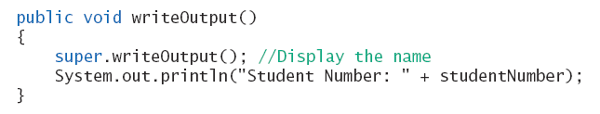
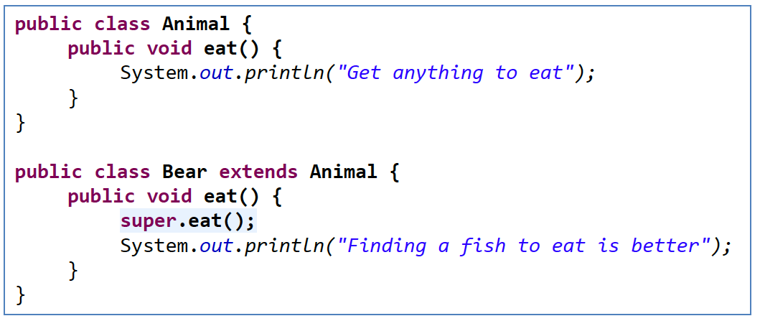
Calling an Overridden Method
Reserved word super can also be used to call method in overridden method
Calls method by same name in base class

Slide 32
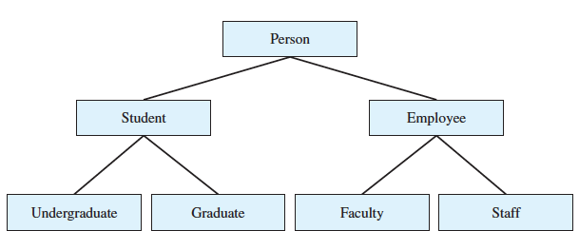
A derived class of a derived class
(Listing 8.4) class Undergraduate
class Undergraduate extends Student
Undergraduate has
All the public members of the class Student and Person

Slide 33
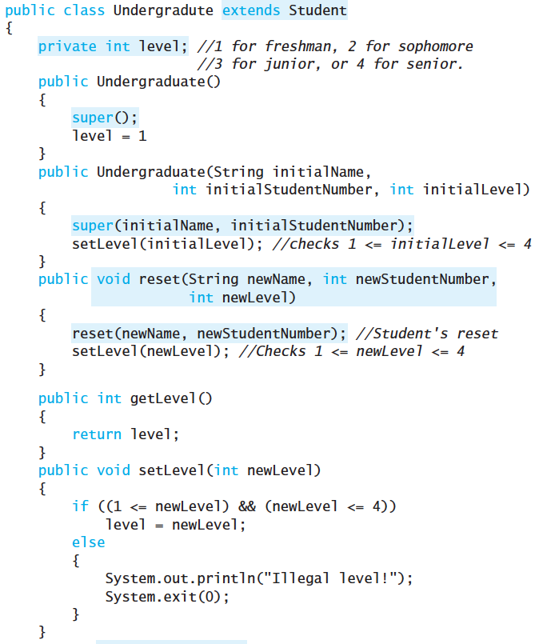
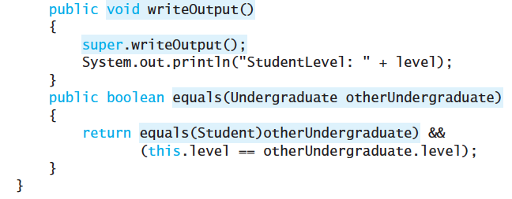
Undergraduate has
All the public members of the class Student and Person

Slide 34
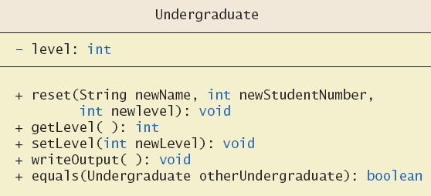
Example
Figure 8.4 More details of the UML class hierarchy

Slide 35
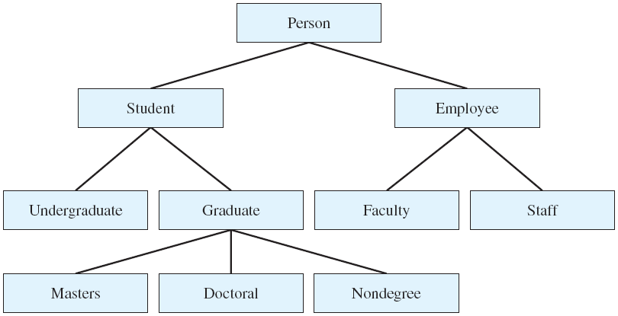
is-a Relationship
Inheritance relationship is known as an is-a relationship
An Undergraduate is a Student; A Student is a Person
A Student is an Undergraduate? Not necessarily!

Slide 36
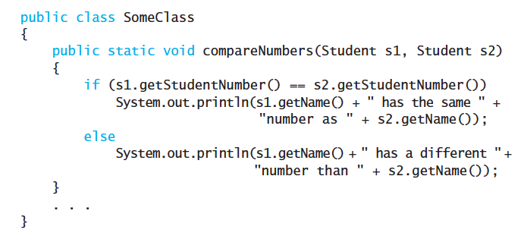
Type compatibility
Suppose:
Does the following work?
Student s = new Student(“Mansoo”, 1234);
Undergraduate ug = new Undergraduate(“Jack”, 1234, 1);
SomeClass.compareNumbers(s, ug);
An object ug of the class Undergraduate is an object of Student ??

Slide 37
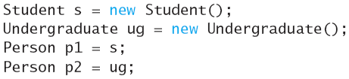

Type compatibility
An object can have several types due to inheritance
An object of a class can be referenced by a variable of a base class
An object of a derived class can behave as an object of the base class
E.g., Every object of the class Undergraduate is also an object of Student as well as Person
Note: this is not typecasting
A Student is a Person
Ug is a Person
Person is a student?
Person is a ug?

Slide 38
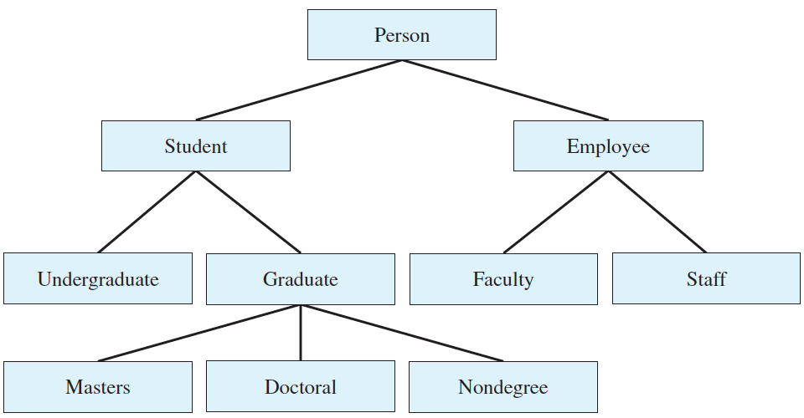
Type compatibility
wider
Basic rule
The classes higher up in the hierarchy are wider or general than those lower down
Similarly, lower classes are narrower or specific
Widening conversion: assign a subtype to a supertype
Fine!. it can be checked at compile time. No action needed
Narrowing conversion: convert a reference of a supertype into a reference of a subtype
must be explicitly converted by using the cast operator
narrower

Slide 39
Type compatibility
Similar to primitive types, you can cast a variable to a different type
Syntax Rule: (Class_Name)variable_of_object
Person p = new Student();
Student s = (Student) p;
A run-time error happens if the cast is incorrect
Person p = new Person();
Student s = (Student) p; // WRONG! p cannot be cast to student
Doctoral d = (Doctoral) p; // WRONG! p is not in Doctoral type

Slide 40
Exercise
public class Car {
public void run() { System.out.println("Car의 run 메소드"); }
}
public class Bus extends Car {
public void sound() {
System.out.println("Bus 의 sound 메소드");
}
public void run() {
System.out.println("Bus 의 run 메소드");
}
public static void main(String[] args) {
Car c = new Bus(); // Can we change new Car?
c.run();
// c.sound(); // how can we use c.sound()?
Bus b = c; // change here
b.run();
b.sound();
}
}

Slide 41
Instanceof operator
instanceof
You need to test an object’s actual class using instanceof operator
It returns a boolean value indicating if an object is of a given class type
Similar to a comparison (==) operator
Syntax:
if (object instanceof ClassName) ClassName newVar = (ClassName)object;
Example:
if (obj instanceof String) String str = (String)obj;
if (c instanceof Bus) {
Bus b = (Bus) c;
b.run();
b.sound();
}

Slide 42
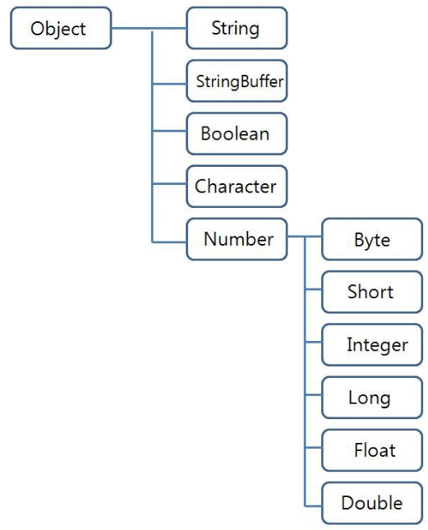
Object Class
Every class in Java inherits a base class “Object”
You don’t have to write “extends” explicitly
Every class in Java is an object
Class Object has several methods and so every class inherits the public methods of object
Examples
Method equals
Method toString
e.g. java.lang package
No need to import!
https://docs.oracle.com/javase/7/docs/api/java/lang/Object.html

Slide 43
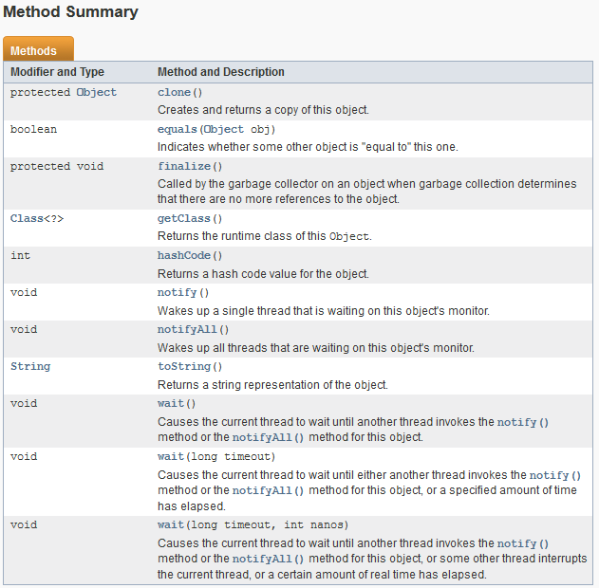
현 객체를 복사
두 개의 객체가 같은지 비교하여 같으면 true를, 같지 않으면 false를 반환
가비지 컬렉션 직전에 객체의 리소스를 정리
객체의 클래스형을 반환
wait된 스레드 실행을 재개할 때 호출
현재 객체의 문자열을 반환
스레드를 일시적으로 중지

Slide 44
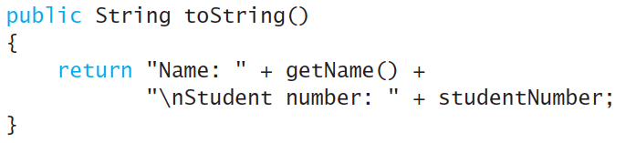
Object Class
Example: Method toString called when println(theObject) invoked
Best to define your own toString to handle this
Overriding!

Slide 45
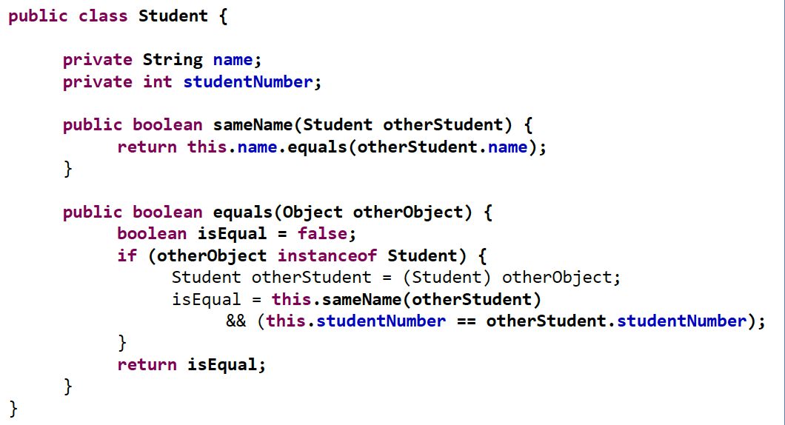
A Better equals Method
Programmer of a class should override method equals from Object
View code of sample override, listing 8.5 public boolean equals(Object theObject)
주의!
Equal 기본 정의가 object를 인자로 받도록 되어 있음
Student 객체 활용을 위해 type casting

Slide 46
Practice 6
Ex6. Define a class Doctor extending Person
Attributes:
specialty (String): “Medicine”, “Surgery”, “Dentist”, or “Oriental”
visit_fee (double)
Methods
Constructors with 0 and 3 (name, specialty, fee) parameters: should call appropriate constructors of Person class
Accessor/mutator methods: check validity
toString(), equals(Object)
Write a test class
Run with ≥ 2 objects
Set two doctor instances
Compare two instances

Slide 47
public class Person {
private String name;
public Person() {
name = "No name yet";
}
public Person(String initialName) {
name = initialName;
}
public void setName(String newName) {
name = newName;
}
public String getName() {
return name;
}
public void writeOutput() {
System.out.println("Name: " + name);
}
public boolean hasSameName(Person otherPerson) {
return this.name.equalsIgnoreCase(otherPerson.name);
}
}
Use this!

Slide 48
Fill out the doctor class
and write a test class (or method)
public class Doctor extends Person {
String specialty;
double visit_fee;
public Doctor() { }
public Doctor(String name, String specialty, double visit_fee) { }
public void setSpecialty(String specialty) {
String major[] = { "Medicine", "Surgery", "Dentist", "Oriental" };
// define your code more!
}
public String getSpecialty() { }
public void setVisitFee(double visit_fee) { }
public double getVisitFee() { }
@Override
public String toString() { }
@Override
public boolean equals(Object otherObject) { }
}

Slide 49
8.3 Polymorphism

Slide 50
Question…
Why do we use inheritance ?
To reuse codes??

Slide 51
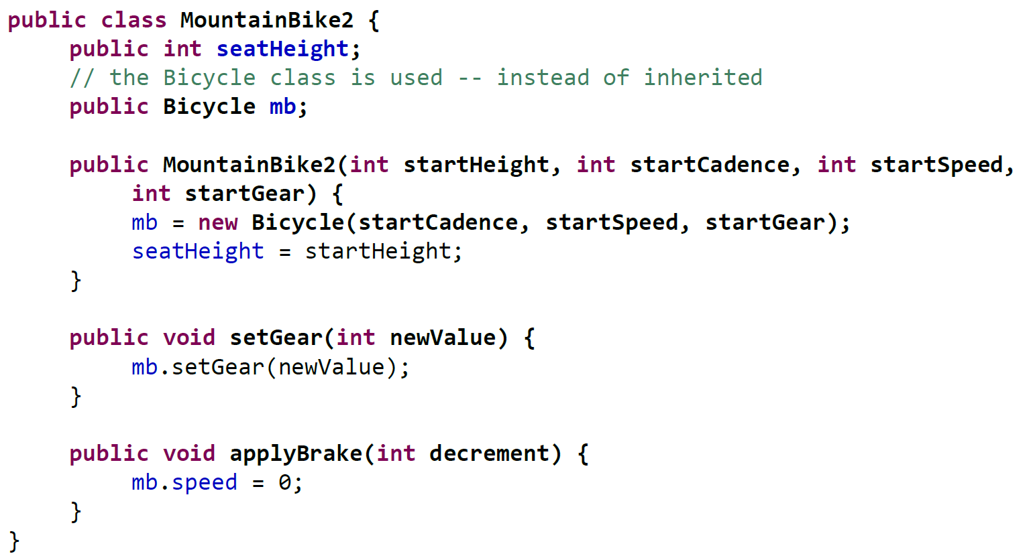
Let’s see
You can reuse codes without inheritance!!

Slide 52
Inheritance is not all for reusability
Inheritance can be good for reusability
But, it is not intended for reusability
That means, if you want to reuse your code, you shall not think about inheritance first!
Inheritance is for flexibility !!
It is used when different objects need different methods
We call this property “polymorphism”
We will see soon.

Slide 53
Polymorphism
It means “many forms”
Same instruction to mean different things in different contexts.
Example: “Go play your favorite sport.”
I’d go play soccer
Others of you would play basketball or football instead.
In programming, this means that the same method name can cause different actions depending on what object it is applied to

Slide 54
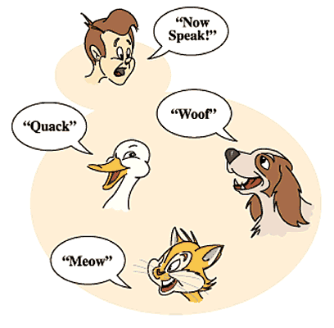
Why is Polymorphism Required?
Let’s consider if we want to design a set of classes that represents animals
Every animal can play its own sound
How to write a method for playing sound ?

Slide 55
Animal Class without Polymorphism
public class Animal {
private String animalName;
private String species;
private void playDuckSound() {
// play "QUACK"
}
private void playDogSound() {
// play "WOOF"
}
private void playCatSound() {
// play "MEW"
}
public void speak() {
if (species.equals("Duck")) {
this.playDuckSound();
} else if (species.equals("Dog")) {
this.playDogSound();
} else if (species.equals("Cat")) {
this.playCatSound();
}
}
}

Slide 56
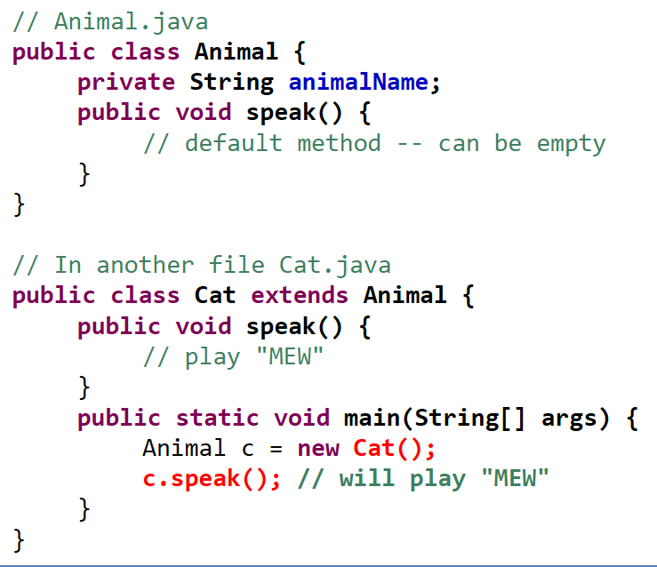
Polymorphism and Overriding
Key Point:
When you invoke the methods from the superclass variable, the overridden method is called

Slide 57
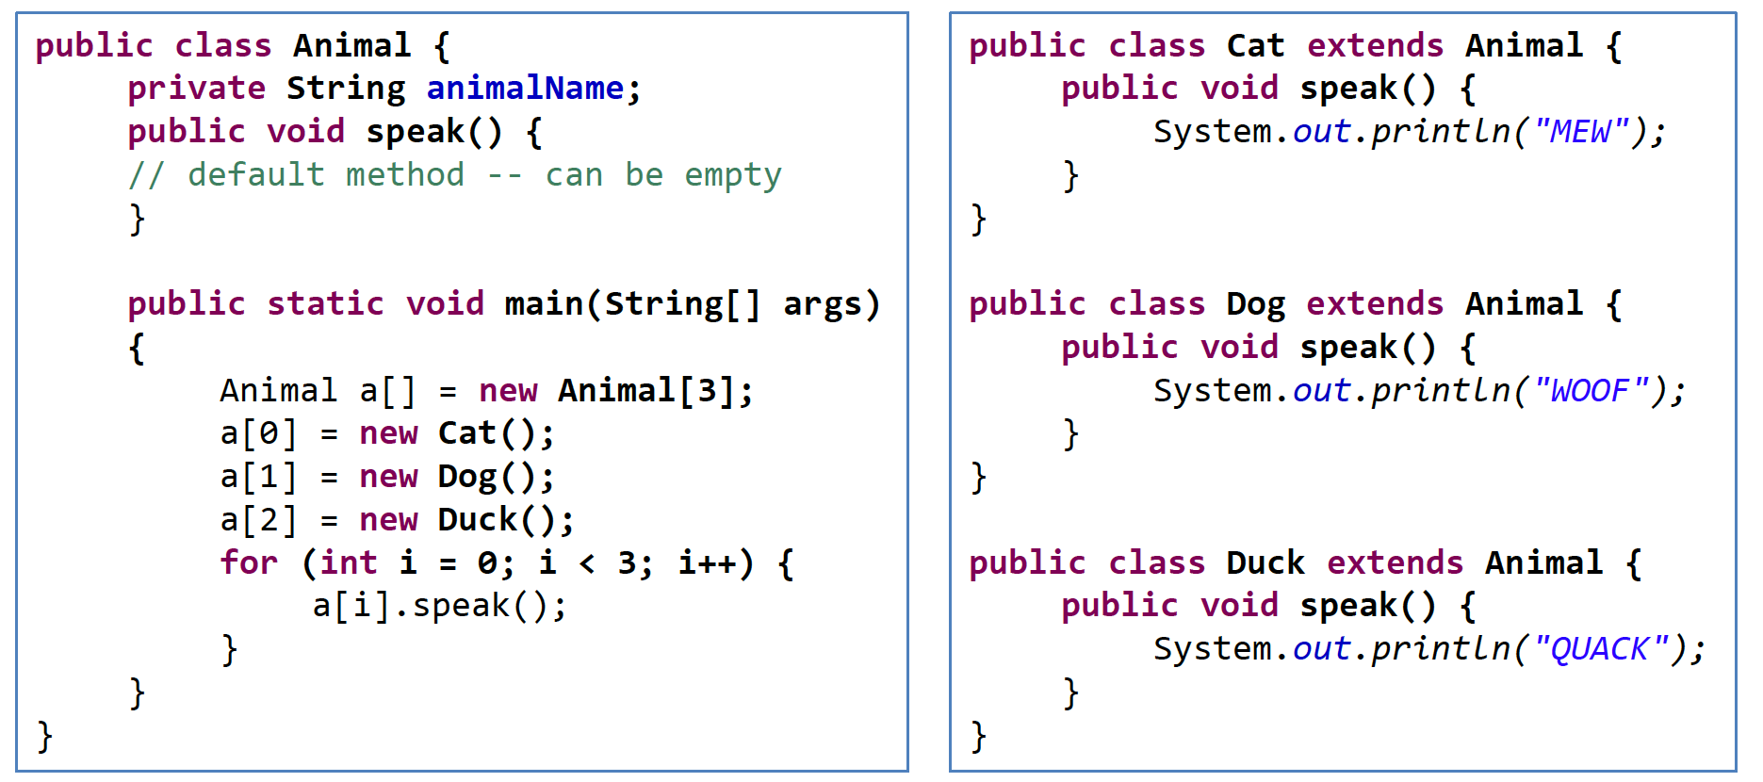
VERY IMPORTANT!
OUTPUT = ?

Slide 58
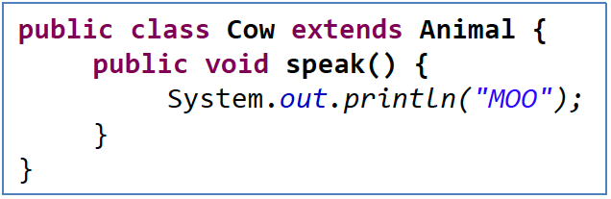
Polymorphism
What if we want to add a new animal: cow?
Just write a new class Cow
Nothing in Animal shall be changed

Slide 59
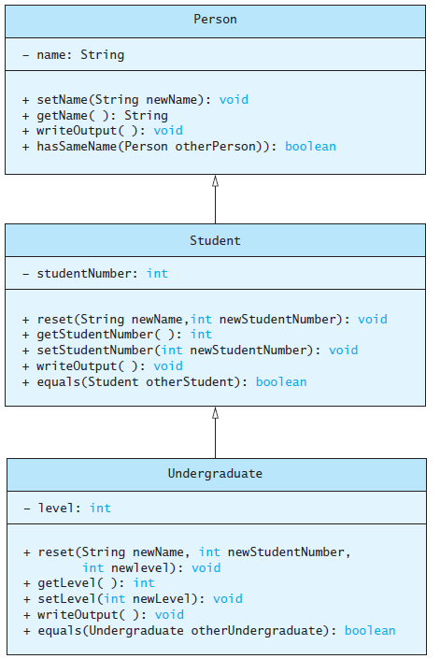
Polymorphism
Consider an array of Person
Person[] people = new Person[4];
Since Student and Undergraduate are types of Person, we can assign them to Person variables
people[0] = new Student("DeBanque, Robin", 8812);
people[1] = new Undergraduate("Cotty, Manny", 8812, 1);

Slide 60
Polymorphism
Given:
Person[] people = new Person[4];
people[0] = new Student("DeBanque, Robin", 8812);
When invoking:
people[0].writeOutput();
Which writeOutput() is invoked, the one defined for Student or the one defined for Person?
Answer: The one defined for Student

Slide 61
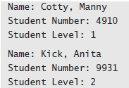
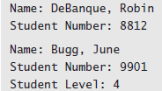
Polymorphism Example
View sample class, listing 8.6 class PolymorphismDemo
Output

Slide 62
public class Person{
private String name;
public Person () { name = "No name yet"; }
public Person (String initialName) { name = initialName; }
public void setName (String newName) { name = newName; }
public String getName () { return name; }
public void writeOutput () { System.out.println ("Name: " + name); }
public boolean hasSameName (Person otherPerson) { return this.name.equalsIgnoreCase otherPerson.name);
}
}
public class Student extends Person{
private int studentNumber;
public Student () {
super ();
studentNumber = 0; //Indicating no number yet
}
public Student (String initialName, int initialStudentNumber) {
super (initialName);
studentNumber = initialStudentNumber;
}
public void reset (String newName, int newStudentNumber) {
setName (newName);
studentNumber = newStudentNumber;
}
public int getStudentNumber () { return studentNumber; }
public void setStudentNumber (int newStudentNumber) { studentNumber = newStudentNumber; }
public void writeOutput () {
System.out.println ("Name: " + getName ());
System.out.println ("Student Number: " + studentNumber);
}
public boolean equals (Student otherStudent) {
return this.hasSameName (otherStudent) &&
(this.studentNumber == otherStudent.studentNumber);
}
}

Slide 63
public class Undergraduate extends Student{
private int level; //1 for freshman, 2 for sophomore,
//3 for junior, or 4 for senior.
public Undergraduate () {
super ();
level = 1;
}
public Undergraduate (String initialName, int initialStudentNumber, int initialLevel) {
super (initialName, initialStudentNumber);
setLevel (initialLevel); //Checks 1 <= initialLevel <= 4
}
public void reset (String newName, int newStudentNumber, int newLevel) {
reset (newName, newStudentNumber); //Students reset
setLevel (newLevel); //Checks 1 <= newLevel <= 4
}
public int getLevel () { return level; }
public void setLevel (int newLevel) {
if ((1 <= newLevel) && (newLevel <= 4)) level = newLevel;
else {
System.out.println ("Illegal level!");
System.exit (0);
}
}
public void writeOutput () {
super.writeOutput ();
System.out.println ("Student Level: " + level);
}
public boolean equals (Undergraduate otherUndergraduate) {
return equals ((Student) otherUndergraduate) &&
(this.level == otherUndergraduate.level);
}
}

Slide 64
Test class
public class PolymorphismDemo {
public static void main(String[] args){
Person[] people = new Person[4];
people[0] = new Undergraduate("Cotty, Manny", 4910, 1);
people[1] = new Undergraduate("Kick, Anita", 9931, 2);
people[2] = new Student("DeBanque, Robin", 8812);
people[3] = new Undergraduate("Bugg, June", 9901, 4);
for (Person p : people)
{
p.writeOutput();
System.out.println();
}
}
}

Slide 65
8.4 Interfaces and Abstract Classes

Slide 66
abstract Classes
Abstract method
A method with only signature (method name, a list of arguments, and return type)
No implementation (method body)
Use the keyword abstract for its declaration
Abstract class
A class containing one or more abstract methods
Abstract classes cannot have an instance
An abstract class must be declared with a class-modifier abstract

Slide 67
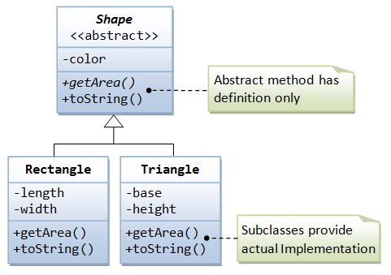
abstract method
For example, in the Shape class, we can declare the abstract methods getArea() as follows:
abstract public class Shape {
// Private member variable
private String color;
// Constructor
public Shape (String color) {
this.color = color;
}
@Override
public String toString() {
return "Shape of color=\"" + color + "\"";
}
// All Shape subclasses must implement a method called getArea()
abstract public double getArea();
}

Slide 68
Why using abstract methods?
Implementation of these methods is not possible in the base class, since the actual implementation will be defined in subclasses ( not yet known)
Example:
The method getArea() in the Shape class is not yet known! (How to compute the area if the shape is not known?)
Implementation of these abstract methods will be provided later once the actual shape is known.
These abstract methods cannot be invoked because they have no implementation.
E.g., Shape s = new Shape(); s.getArea();

Slide 69
abstract Classes
An abstract class must be declared with a class-modifier abstract.
A class containing one or more abstract methods is called an abstract class.
abstract public class Shape {
// Private member variable
private String color;
// Constructor
public Shape (String color) {
this.color = color;
}
@Override
public String toString() {
return "Shape of color=\"" + color + "\"";
}
// All Shape subclasses must implement a method called getArea()
abstract public double getArea();
}

Slide 70
abstract Classes
Not all methods of an abstract class are abstract methods
Abstract class makes it easier to define a base class
Specifies the obligation of designer to override the abstract methods for each subclass

Slide 71
How to use abstract class
Accessing by inheritance!
public class abstractTest {
public static void main(String[] args) {
A obj1 = new A(); //error!
B obj2 = new B();
}
}
abstract class A{
public abstract int b();
public void c(){ System.out.println("error");}
public void d(){ System.out.println("test"); }
}
class B extends A{
public int b(){ return 1;}
}

Slide 72
Lab: calculator
abstract class Calculator{
int left, right;
public void setOprands(int left, int right){
this.left = left;
this.right = right;
}
public abstract void sum();
public abstract void avg();
public void run(){
sum();
avg();
}
}
class CalculatorA extends Calculator {
public void sum(){
System.out.println("+ sum :"+(this.left+this.right));
}
public void avg(){
System.out.println("+ avg :"+(this.left+this.right)/2);
}
}
class CalculatorB extends Calculator {
public void sum(){
System.out.println("- sum :"+(this.left+this.right));
}
public void avg(){
System.out.println("- avg :"+(2/(1/this.left)+(1/this.right));
}
}
public class CalculatorDemo {
public static void main(String[] args) {
CalculatorA c1 = new CalculatorA();
c1.setOprands(10, 20);
c1.run();
CalculatorB c2 = new CalculatorB();
c2.setOprands(10, 20);
c2.run();
}
}
산술 평균
조화 평균

Slide 73
Interfaces
A way to describe what classes should do, without specifying how they should do it
Contains headings for a number of public methods
All methods are public abstract methods
A set of requirements for a class that wants to conform to the interface
Example:
public interface Measurable {
public static final int INCHES_PER_FOOT = 12;
// Returns the perimeter
public double getPerimeter();
// Returns the area
public double getArea();
}

Slide 74
Interface declarations
Interface members
Constants (fields)
Method signatures
Nested classes and interfaces
Does not include:
Declarations of constructors
Instance variables
Method bodies
Interface name begins with uppercase letter
Stored in a file with suffix .java

Slide 75
Make a Class Implementing an Interface
Two steps to make a class implement an interface
1. declare that the class intends to implement the given interface by using the implements keyword
implements Interface_name
e.g., class Employee implements Comparable { . . . }
2. Define all specified methods in the interface

Slide 76
Example: Rectangle class
/** A class of rectangles. */
public class Rectangle implements Measurable{
private double myWidth;
private double myHeight;
public Rectangle (double width, double height)
{
myWidth = width;
myHeight = height;
}
public double getPerimeter()
{
return 2 * (myWidth + myHeight);
}
public double getArea()
{
return myWidth * myHeight;
}
}
public interface Measurable {
public static final int INCHES_PER_FOOT = 12;
// Returns the perimeter
public double getPerimeter();
// Returns the area
public double getArea();
}

Slide 77
Example: Circle class
/** A class of circles. */
public class Circle implements Measurable{
private double myRadius;
public Circle(double radius)
{
myRadius = radius;
}
public double getPerimeter ()
{
return 2 * Math.PI * myRadius;
}
public double getCircumference ()
{
return getPerimeter ();
}
public double getArea ()
{
return Math.PI * myRadius * myRadius;
}
}
public interface Measurable {
public static final int INCHES_PER_FOOT = 12;
// Returns the perimeter
public double getPerimeter();
// Returns the area
public double getArea();
}

Slide 78
Interface as a type
Interfaces are not classes
Measurable x = new Measurable(); // WRONG!
You can still declare an interface variable; it refers to an object of a class that implements the interface
Measurable m = new Rectangle(); // OK
Benefits?
Allows you to view classes that are not related at all to a single type.
Measurable[] arr = new Shape[2];
arr[0] = new Rectangle( );
arr[1] = new Circle( );

Slide 79
Extending interfaces
Interfaces support multiple inheritance
An interface can extend more than one interface
Superinterfaces and subinterfaces
A class that implements the new interface must implement all the methods of both interfaces
Example
public interface SerializableRunnable extends java.io.Serializable, Runnable {
. . .
}

Slide 80
Why using interfaces?
An interface is a contract (or a protocol-규약, or a common understanding) of what the classes can do.
When a class implements a certain interface, it promises to provide implementation to all the abstract methods declared in the interface.
1. interfaces provide a communication contract between two objects.
If you know a class implements an interface, then you are guaranteed to be able to invoke these methods safely
2. Java does not support multiple inheritance; that is supplemented by “multiple implementation of interfaces”

Slide 81
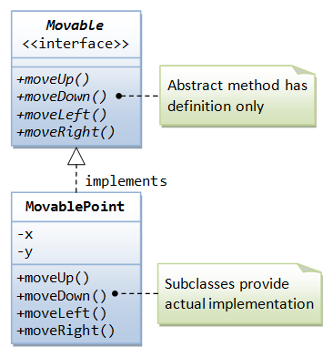
Lab: Movable Interface
Suppose that our application involves many objects that can move. We could define an interface called Movable, containing the signatures of the various movement method.

Slide 82
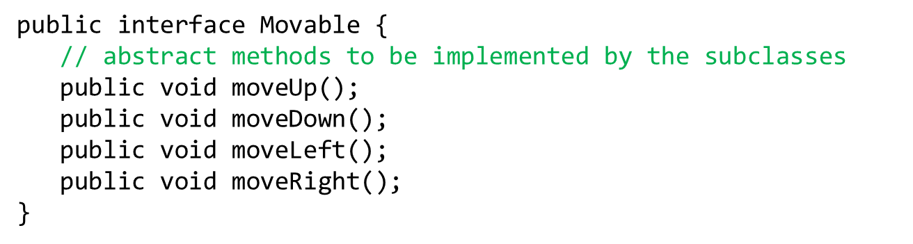
1. Define interface Movable!
Moveable.java

Slide 83
2. MovablePoint.java
public class MovablePoint implements Movable {
// Private member variables
private int x, y; // (x, y) coordinates of the point
// Constructor
public MovablePoint(int x, int y) {
this.x = x;
this.y = y;
}
@Override
public String toString() {
return "Point at (" + x + "," + y + ")";
}
// Implement abstract methods
// defined in the interface Movable
@Override
public void moveUp() {
y--;
}
@Override
public void moveDown() {
y++;
}
@Override
public void moveLeft() {
x--;
}
@Override
public void moveRight() {
x++;
}
}

Slide 84
Test Program
public class TestMovable {
public static void main(String[] args) {
Movable m1 = new MovablePoint(5, 5); // upcast
System.out.println(m1); // (5,5)
m1.moveDown();
System.out.println(m1); // (5,6)
m1.moveRight();
System.out.println(m1); // (6,6)
}
}

Slide 85
Lab: Sorting an Array of Fruit Objects
Initial (non-working) attempt to sort an array of Fruit objects
View class definition, listing 8.16 class Fruit
View test class, listing 8.17 class FruitDemo
Result: Exception in thread “main”
Sort tries to invoke compareTo method but it doesn’t exist

Slide 86
Sorting an Array of Fruit Objects
public class Fruit {
private String fruitName;
public Fruit() {
fruitName = "";
}
public Fruit(String name) {
fruitName = name;
}
public void setName(String name) {
fruitName = name;
}
public String getName() {
return fruitName;
}
}
import java.util.Arrays;
public class FruitDemo {
public static void main(String[] args) {
Fruit[] fruits = new Fruit[4];
fruits[0] = new Fruit("Orange");
fruits[1] = new Fruit("Apple");
fruits[2] = new Fruit("Kiwi");
fruits[3] = new Fruit("Durian");
Arrays.sort(fruits);
// Output the sorted array of fruits
for (Fruit f : fruits) { System.out.println(f.getName());
}
}
}
Exception in thread "main" java.lang.ClassCastException: Fruit cannot be cast to java.lang.Comparable
at java.util.ComparableTimSort.countRunAndMakeAscending(Unknown Source)
at java.util.ComparableTimSort.sort(Unknown Source)
at java.util.Arrays.sort(Unknown Source)
at FruitDemo.main(FruitDemo.java:14)

Slide 87
Comparable interface
Exception in thread "main" java.lang.ClassCastException: Fruit cannot be cast to java.lang.Comparable
Why errors in Array.sort()?
As soon as sort () is executed, it is sorted internally according to the content of the method through compareTo ().
Comparable interface
A predefined interface in Java
Impose an ordering upon objects that implement it
Requires compareTo() method to be implemented

Slide 88
Comparable interface
public interface Comparable
{
int compareTo(Object otherObject);
}
This requires that any class implementing the Comparable interface contains a compareTo method, and this method must take an Object parameter and return an integer

Slide 89
Comparable interface
public class Fruit implements java.lang.Comparable {
private String name;
public Fruit() {
name = "";
}
public Fruit(String name) {
this.name = name;
}
@Override
public String toString() {
return name;
}
@Override
public int compareTo(Object obj) {
if (!(obj != null || obj instanceof Fruit)) return 0;
Fruit fruit = (Fruit)obj;
return this.name.compareTo(fruit.name);
}
}

Slide 90
compareTo Method
An alternate definition that will sort by length of the fruit name
public class Fruit implements Comparable{ …
public int compareTo(Object o) {
if ((o != null) && (o instanceof Fruit)) {
Fruit otherFruit = (Fruit) o;
/* Alternate definition of comparison using fruit length */
if (fruitName.length() > otherFruit.fruitName.length())
return 1;
else if (fruitName.length() <otherFruit.fruitName.length())
return -1;
else
return 0;
}
return -1; // Default if other object is not a Fruit
}

Slide 91
Interfaces and abstract classes
Why bother introducing two concepts: abstract class and interface?
abstract class Comparable {
public abstract int compareTo (Object otherObject);
}
class Employee extends Comparable {
pulibc int compareTo(Object otherObject) { . . . }
}
public interface Comparable {
int compareTo (Object otherObject)
}
class Employee implements Comparable {
public int compareTo (Object otherObject) { . . . }
}
A class can only extend a single abstract class, but it can implement as many interfaces as it wants
An abstract class can have a partial implementation, protected parts, static methods and so on, while interfaces are limited to public constants and public methods with no implementation

Slide 92
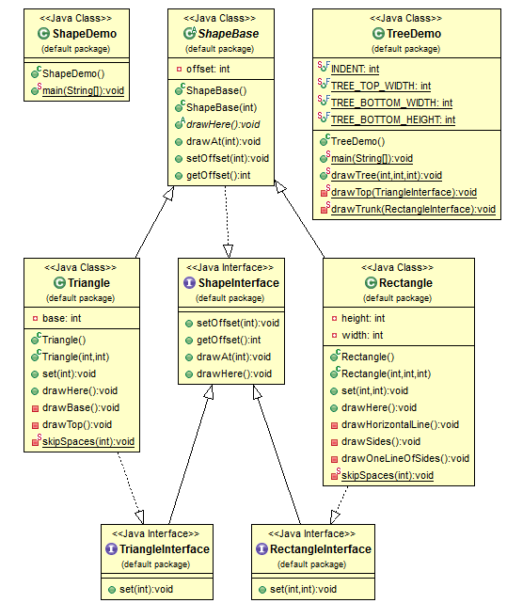
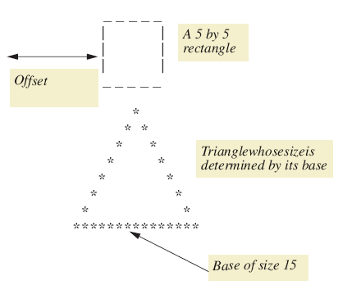
Lab: Character Graphics
View interface for simple shapes, listing 8.10 interface ShapeInterface
To create classes that draw rectangles and triangles, we create interfaces that extend ShapeInterface

Slide 93
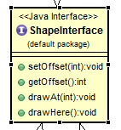
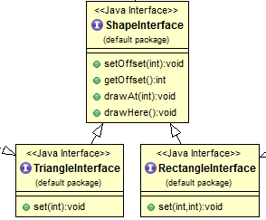
- All member variables must be public static final and can be omitted.
- All methods must be public abstract and can be omitted.
/*Interface for a rectangle to be drawn on the screen.*/
public interface RectangleInterface extends ShapeInterface
{
/* Sets the rectangle's dimensions. */
public void set (int newHeight, int newWidth);
}
/*Interface for a triangle to be drawn on the screen.*/
public interface TriangleInterface extends ShapeInterface{
/* Sets the triangle's base. */
public void set (int newBase);
}
/*Interface for simple shapes drawn on
the screen using keyboard characters.*/
public interface ShapeInterface
{
/*Sets the offset for the shape. */
public void setOffset (int newOffset);
/*Returns the offset for the shape.*/
public int getOffset ();
/* Draws the shape at lineNumber lines
down from the current line. */
public void drawAt (int lineNumber);
/* Draws the shape at the current line.
*/
public void drawHere ();
}

Slide 94
Lab: Character Graphics
Now view base class, listing 8.12 which uses (implements) previous interfaces class ShapeBasics
Note
Method drawAt calls drawHere
Derived classes must override drawHere
Modifier extends comes before implements

Slide 95
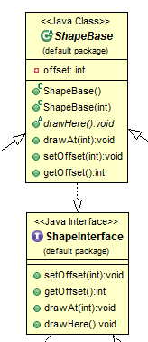
public class ShapeBasics implements ShapeInterface {
private int offset;
public ShapeBasics () {
offset = 0;
}
public ShapeBasics (int theOffset) {
offset = theOffset;
}
public void setOffset (int newOffset) {
offset = newOffset;
}
public int getOffset () {
return offset;
}
public void drawAt (int lineNumber) {
for (int count = 0 ; count < lineNumber ; count++)
System.out.println ();
drawHere ();
}
public void drawHere () {
for (int count = 0 ; count < offset ; count++)
System.out.print (' ');
System.out.println ('*');
}
}
위에서 몇칸을 띄워서 그릴 것인가. 결국 그림은 drawHere에서 그림
/*Interface for simple shapes drawn on
the screen using keyboard characters.*/
public interface ShapeInterface
{
/*Sets the offset for the shape. */
public void setOffset (int newOffset);
/*Returns the offset for the shape.*/
public int getOffset ();
/* Draws the shape at lineNumber lines
down from the current line. */
public void drawAt (int lineNumber);
/* Draws the shape at the current line.
*/
public void drawHere ();
}
옆으로 몇칸을 띄워서 그릴것인가

Slide 96
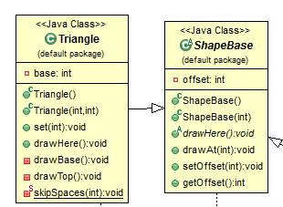
public class Rectangle extends ShapeBasics implements RectangleInterface {
private int height;
private int width;
public Rectangle (){
super ();
height = 0;
width = 0;
}
public Rectangle (int theOffset, int theHeight, int theWidth){
super (theOffset);
height = theHeight;
width = theWidth;
}
public void set (int newHeight, int newWidth){
height = newHeight;
width = newWidth;
}
public void drawHere () {
drawHorizontalLine ();
drawSides ();
drawHorizontalLine ();
}
private void drawHorizontalLine (){
skipSpaces (getOffset ());
for (int count = 0 ; count < width ; count++)
System.out.print ('-');
System.out.println ();
}
method drawHere to draw rectangle
Draw the top line
Draw the side lines
Draw the bottom lines
private void drawSides (){
for (int count = 0 ; count < (height - 2) ; count++)
drawOneLineOfSides ();
}
private void drawOneLineOfSides (){
skipSpaces (getOffset ());
System.out.print ('|');
skipSpaces (width - 2);
System.out.println ('|');
}
private static void skipSpaces (int number){
for (int count = 0 ; count < number ; count++)
System.out.print (' ');
}
}

Slide 97
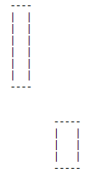
Test 1: draw box
public class ShapeDemo{
public static void main(String[] args) {
Rectangle box = new Rectangle(2, 8, 4);
box.drawHere();
box.set(5, 5);
box.setOffset(10);
box.drawAt(2); // 2줄 건너뛰고 그려라
}
}
Output
Offset 2
Offset 10

Slide 98
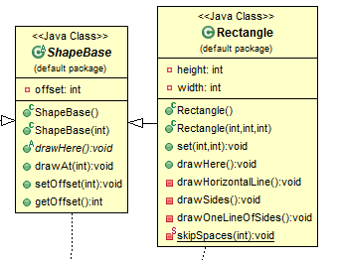
public class Triangle extends ShapeBasics implements TriangleInterface {
private int base;
public Triangle (){
super ();
base = 0; }
public Triangle (int theOffset, int theBase){
super (theOffset);
base = theBase;}
public void set (int newBase){ base = newBase; }
public void drawHere () {
drawTop ();
drawBase (); }
private void drawBase () {
skipSpaces (getOffset ());
for (int count = 0 ; count < base ; count++)
System.out.print ('*');
System.out.println (); }
private void drawTop (){
int startOfLine = getOffset () + base / 2;
skipSpaces (startOfLine);
System.out.println ('*'); //top '*'
int lineCount = base / 2 - 1; //height above base
int insideWidth = 1;
for (int count = 0 ; count < lineCount ; count++) {
startOfLine--;
skipSpaces (startOfLine);
System.out.print ('*');
skipSpaces (insideWidth);
System.out.println ('*');
insideWidth = insideWidth + 2;
} }
private static void skipSpaces (int number){
for (int count = 0 ; count < number ; count++)
System.out.print (' '); }
}

Slide 99
Test 2: draw tree
Save the Redwoods!
*
* *
* *
* *
* *
* *
* *
* *
* *
* *
*********************
----
| |
| |
----
public class TreeDemo {
public static final int INDENT = 5; // offset
public static final int TREE_TOP_WIDTH = 21; // odd, base length
public static final int TREE_BOTTOM_WIDTH = 4; // rectangle w
public static final int TREE_BOTTOM_HEIGHT = 4; // rectangle h
public static void main (String [] args) {
drawTree (TREE_TOP_WIDTH, TREE_BOTTOM_WIDTH,
TREE_BOTTOM_HEIGHT);
}
public static void drawTree (int topWidth, int bottomWidth, int bottomHeight) {
System.out.println (" Save the Redwoods!");
Triangle treeTop = new Triangle (INDENT, topWidth);
drawTop (treeTop);
Rectangle treeTrunk = new Rectangle (INDENT+(topWidth/2)– (bottomWidth / 2),
bottomHeight, bottomWidth);
drawTrunk (treeTrunk);
}
private static void drawTop (TriangleInterface treeTop) {
treeTop.drawAt (1);
}
private static void drawTrunk (RectangleInterface treeTrunk) {
treeTrunk.drawHere (); // or treeTrunk.drawAt(0);
}
}

